Slide 1

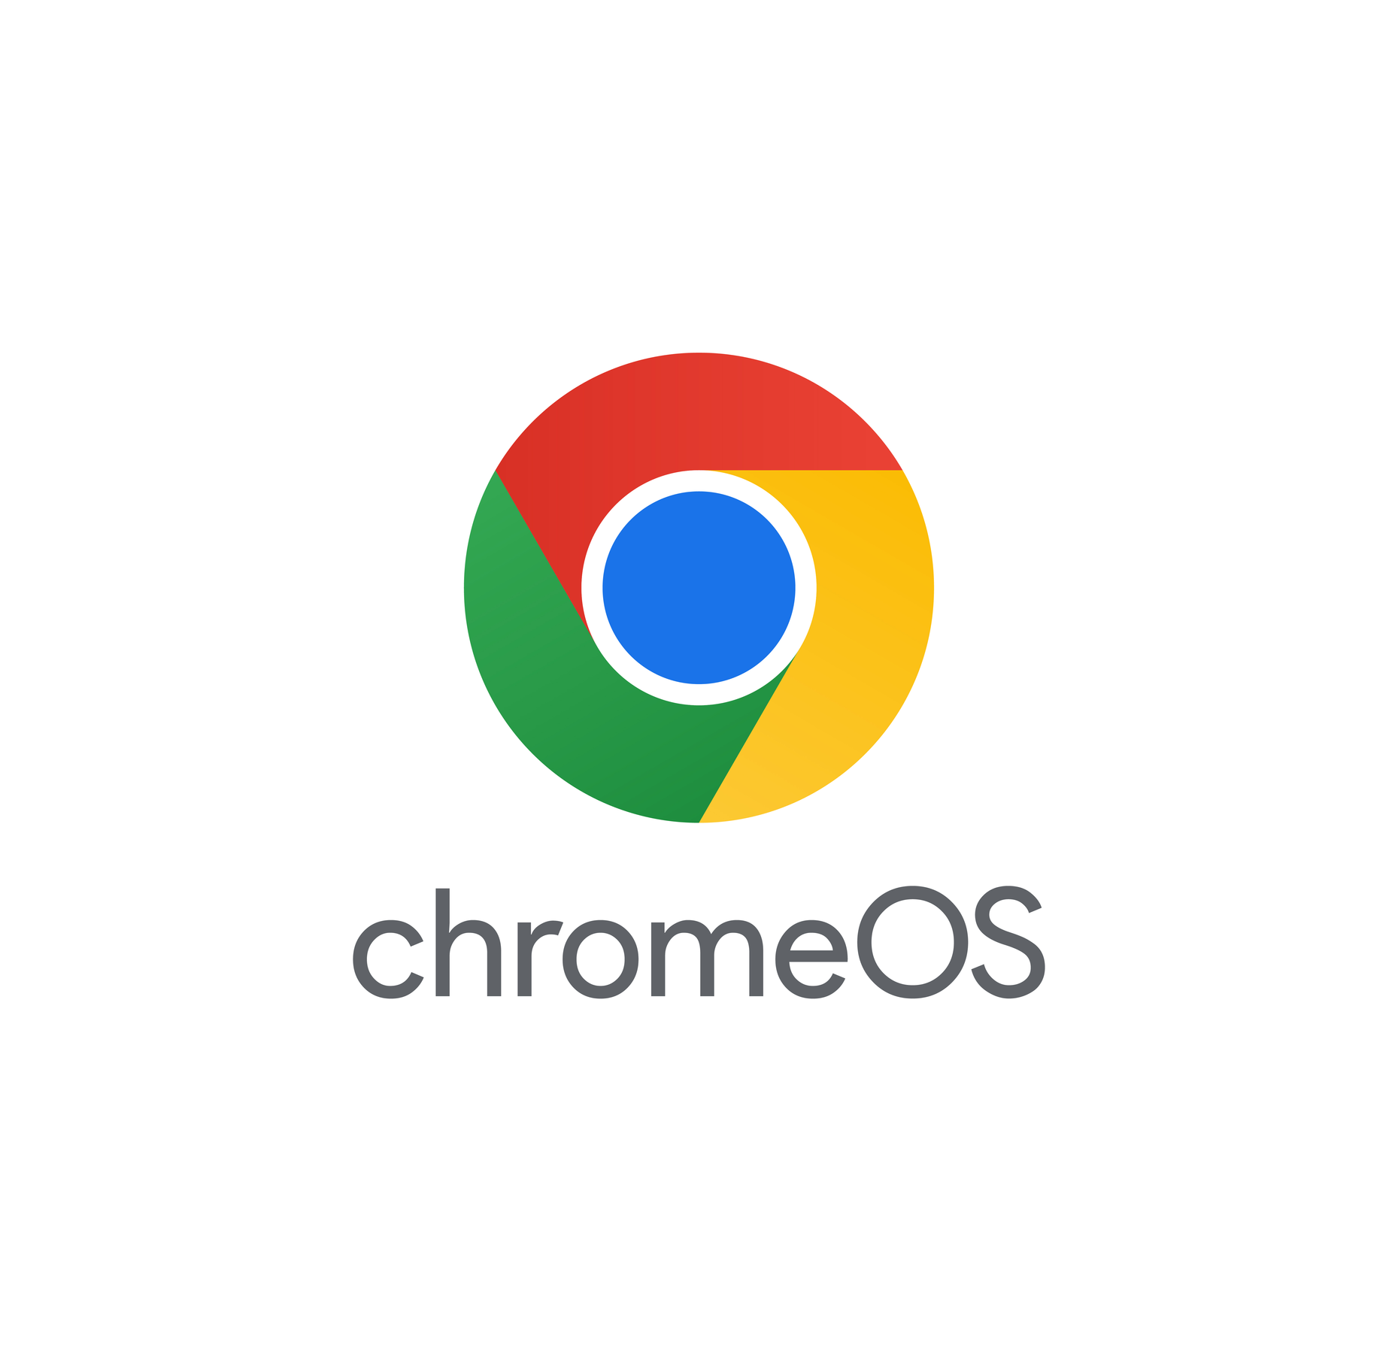
CHROME
OS
Created by:
Sanyo Fonseca - 9896
Vedang Mirgal - 9918
Allan Monis - 9920
Hardik Murudi - 9921

Slide 2
INTRODUCTION
Chrome OS is a lightweight, cloud-centric operating system developed by Google, designed primarily for Chromebooks. It revolves around the Chrome browser, emphasizing speed, simplicity, and security. With seamless integration of Google services and web applications, Chrome OS offers a user-friendly experience ideal for browsing, productivity, and education, relying on cloud storage and web-based tools.

Slide 3


ARCHITECTURE OF CHROME OS
Its architecture revolves around the Linux kernel, with the Chrome browser serving as the primary interface.
Linux kernel: Core OS operations, hardware communication, and resource management.
Chrome Browser: User interface, web browsing, application execution, and content rendering.
Component Framework: Bridges browser with hardware for seamless functionality and compatibility.
Security Features: Isolation of processes, regular updates, and secure boot process.

Slide 4
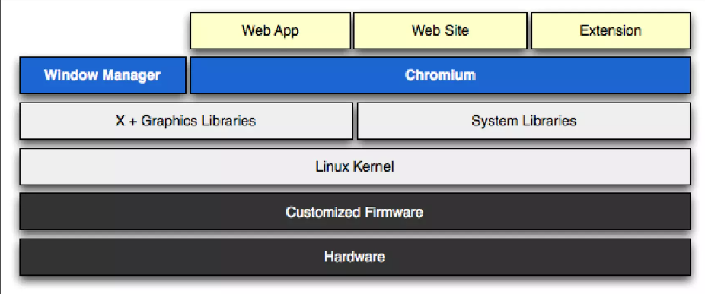
ARCHITECTURE OF CHROME OS

Slide 5
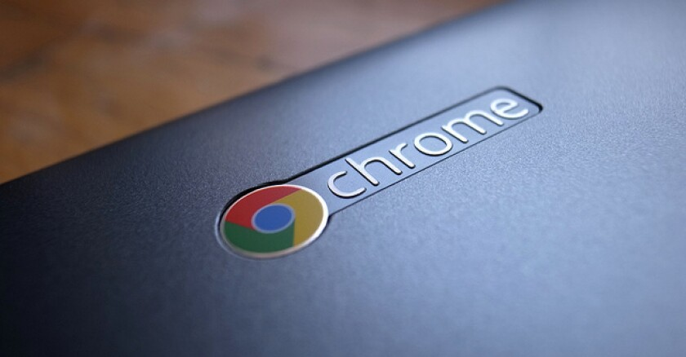

CHROMEBOOKS
Chromebooks feature lightweight hardware optimized for web-centric tasks.
Common specs include low-powered processors
Displays range from 11 to 15 inches, often with hd or full hd resolution.
Battery life exceeds 8 hours.
Connectivity options include Wi-Fi, Bluetooth, USB ports, and cellular data.

Slide 6


Sandboxing: Isolates processes for enhanced security.
Automatic Updates: Regular patches for vulnerabilities and improvements
Verified Boot: Ensures system integrity during startup.
Data Encryption: Protects user data from unauthorized access
Chrome Browser Security: Built-in defenses against malware and phishing
Device Management: Admin controls for security policies and permissions
Verified Access: Authentication measures for secure user logins
Remote Wipe: Ability to erase data remotely in case of theft or loss
SECURITY

Slide 7

UPDATES.
Chrome OS receives frequent updates, ensuring continuous improvement and patching for security vulnerabilities and performance enhancements. These updates are seamlessly delivered in the background, minimizing disruption to users while keeping their devices up-to-date with the latest features and protections..

Slide 8
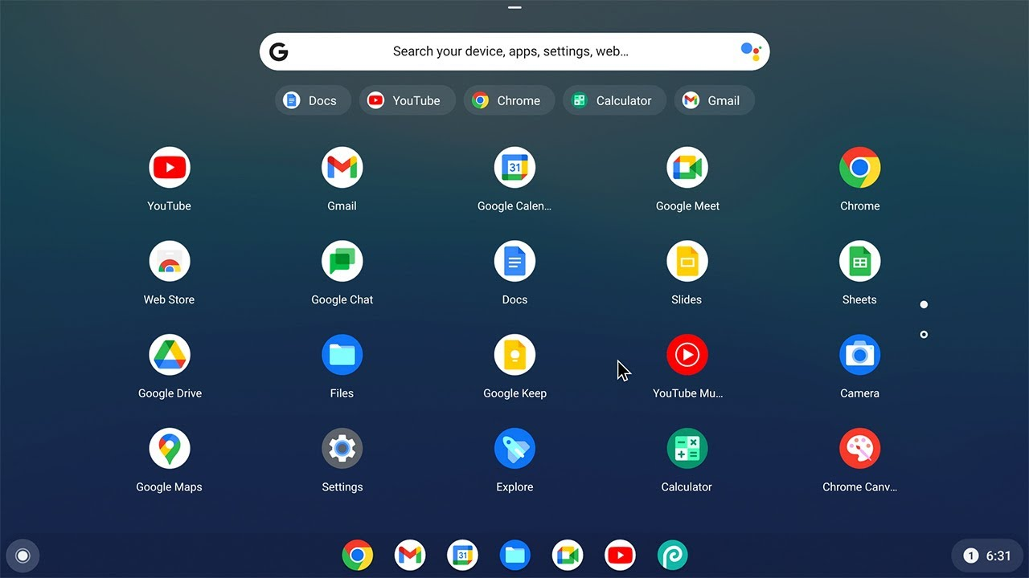

USER INTERFACE
Notification Center:
Centralized hub for system and app notifications.
Settings Menu:
Access system settings for customization and configuration
File Manager:
Simple file management system for organizing documents and media.

Slide 9
USER INTERFACE
Taskbar and Launcher:
Taskbar for quick access to apps and system settings.
Launcher for searching and launching applications.
ADDITIONAL INFORMATION
you can use apps that are of android versions.
you can insert USB device and work with files.

Slide 10
CHROME OS / WINDOWS / MAC OS
CHROME OS
Integrated with Google services and apps.
Limited offline functionality, primarily web-based applications.
WINDOWS
Supports a vast array of software and hardware.
Known for its backward compatibility and gaming capabilities.
MAC OS
Strong focus on creativity and productivity, with built-in tools like Final Cut Pro and Logic Pro.
Known for its sleek design, user-friendly interface

Slide 11


Conclusion
Chrome OS stands out for its speed, simplicity, and security, thriving on an open-source foundation that encourages innovation. It’s designed for efficiency, seamlessly integrating with Google services and supporting Android apps, making it ideal for users and organizations focused on web-based applications.
With its focus on cloud computing and accessibility on diverse hardware, Chrome OS is a cost-effective, user-friendly choice for digital inclusivity and continuous advancement in computing technology.

Slide 12

THANK YOU!!

